Slide 1
PSCS235-A One Stop Solution focusing on Tourism
PIP2001 Capstone Project
Review-1
Batch Number: G45
Under the Supervision of,
Ms. Sreelatha P.K
Associate Professor
School of Computer Science and Engineering
Presidency University
Roll Number | Student Name
20211CSE0846 | VAISHNAVI C
20211CSE0298 | SHRUTHI V
20211CSE0308 | RUTHIKA S SHETTY
Name of the Program: CSE
Name of the HoD: Dr. Asif Mohammed H.B
Name of the Program Project Coordinator: Mr. Amarnath J.L & Dr. Jayanthi. K
Name of the School Project Coordinators: Dr. Abdul Khadar A

Slide 2
Introduction
This project aims to create an innovative data mining solution capable of accurately forecasting tourists' travel preferences, specifically optimizing domestic tour packages' scheduling.
The project has three main objectives:
To build a clustering model that efficiently groups the collected data into distinct clusters for classification purposes.
To develop data mining models using predictive techniques to forecast tourist travel clusters, enabling more effective planning of domestic tour packages.
To provide well-founded and actionable recommendations to the appropriate authorities.

Slide 3
Literature Review
Algorithms Used: Various advanced algorithms such as Knowledge Graphs, AI-based models (e.g., TOPSIS, ABC), Neural Networks (ANN, MLP), Support Vector Machines (SVM), and ensemble techniques like Random Forests were implemented to analyze and predict tourism trends.
Data Sources: Studies relied on diverse datasets, including open government data, climate databases (NOAA), social media data (Facebook, TripAdvisor), and retail campaign records, combining structured and unstructured sources.
Forecasting and Personalization: Predictive models focused on tourism demand forecasting using both traditional data and real-time social media inputs, enhancing accuracy and enabling tailored recommendations for tourists.
Hybrid Models: Many papers utilized hybrid algorithms(e.g., ABC + Fuzzy TOPSIS, Gradient Boosting with BERT) to improve decision-making and forecasting, offering a competitive edge over single-method approaches.
Impact on Tourism: These studies aim to optimize tourism operations through better forecasting, smart destination management, personalized recommendations, and actionable insights, contributing to sustainable tourism growth.

Slide 4
Literature Review
Advantages:
- Enhanced accuracy in predictions and recommendations.
- Integration of multi-source data helps stakeholders in tourism planning.
- Models account for disruptions, such as the COVID-19 pandemic, improving adaptability.
Challenges and Disadvantages:
- High computational demand and complexity in algorithms.
- Overreliance on specific datasets (like TripAdvisor) may limit generalizability.
- Data quality and privacy concerns arise when using social or retail data.

Slide 5
Existing method Drawback
Some tourist destinations or countries may have limited social media activity, especially in rural or less digitally connected areas.
Only published or readily available studies might have been included in the review, leading to potential bias.
Analyzing digital patterns of life often involves tracking personal data, including location, preferences, and behaviors. There are inherent privacy concerns.
Reliance on social media data can introduce biases, as not all demographics are represented equally.
The accuracy of data mining results depends on the quality of the data used. Inaccurate or incomplete data can lead to misleading insights.

Slide 6
Proposed Method
Clustering Tourist Data:
Implement clustering algorithms such as K-means.
Segment data based on demographics, preferences, and behaviors to identify patterns in tourist groups.
Predictive Modeling for Tourist Clusters:
Build time series, regression, and classification models to forecast tourist travel trends.
Predict future changes in cluster composition and behavior.
Result Analysis:
Analyze clusters and predictions to identify trends and tourist preferences.
Focus on key characteristics within each group for targeted insights.
Recommendations for Tourism Authorities:
Provide data-driven suggestions to optimize resource allocation, marketing, and services.
Propose strategic actions for enhancing tourism offerings based on cluster analysis.
Visualization of Clustering and Predictions:
Present the clustering results and predictions in an easily understandable and insightful manner.
Enhance the clarity of results, making the insights more accessible to stakeholders.

Slide 7
Objectives
Objective 1: Develop a robust clustering algorithm for tourist data segmentation
Explore and implement various clustering algorithms (e.g., K-means, hierarchical clustering, DBSCAN) to effectively segment tourist data based on relevant attributes (e.g., demographics, preferences, behaviors).
Objective 2: Construct predictive models for forecasting tourist travel clusters
Develop and evaluate predictive models (e.g., time series analysis, regression models, classification models) to forecast the evolution of tourist clusters over time.
Objective 3: Analyze and interpret the results of clustering and predictive models
Conduct an in-depth analysis of the clusters identified and the predictions generated by the models, identifying key characteristics and trends.
Objective 4: Develop actionable recommendations for tourism authorities
Based on the clustering and predictive results, provide specific and actionable recommendations to tourism authorities, such as optimizing resource allocation, developing targeted marketing campaigns, and improving service offerings.

Slide 8
Methodology/Modules
Methodology:
Data Collection: Gather data from social media, travel platforms, and user interactions.
Data Pre-processing: Clean, normalize, and extract relevant features.
NLP: Analyse text for sentiment, topics, and entities.
Machine Learning: Build models for recommendation, prediction, and clustering.
Visualization: Create interactive dashboards for insights.

Slide 9
Methodology/Modules
Modules:
Python Libraries: pandas, NumPy, scikit-learn, TensorFlow, Keras, NLTK.
Social Media APIs: Twitter, Instagram, Facebook
NLP Tools: spaCy, NLTK

Slide 10
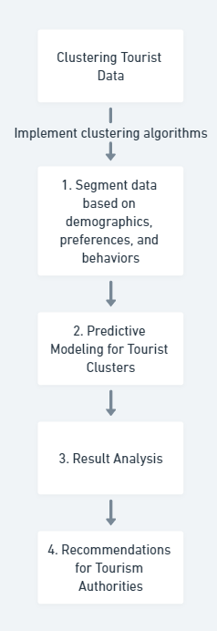
Architecture

Slide 11
Hardware/software components
Python 3. x
Jupyter Notebook / Google Colab
Pandas, NumPy (Data processing)
Matplotlib, Seaborn, Plotly (Visualization)
Scikit-learn, TensorFlow, PyTorch (Machine Learning)
BeautifulSoup / Scrapy (Web scraping)
APIs (Google Maps, OpenWeather, Instagram, etc.)

Slide 12
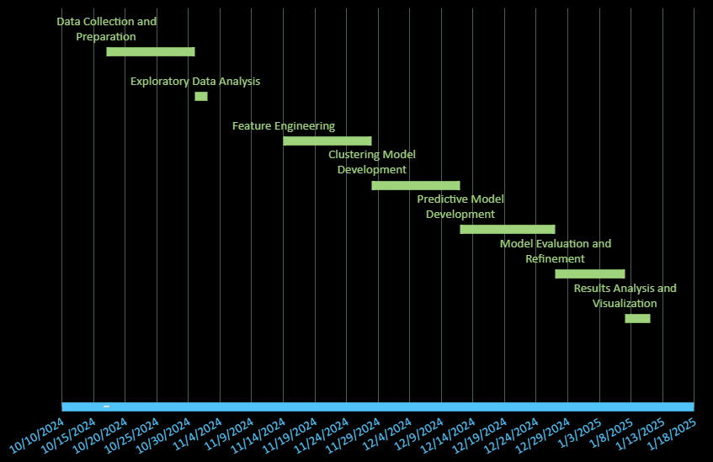
Timeline of Project

Slide 13
Expected Outcomes
1. Accurate Tourist Segmentation:​
The clustering model is expected to effectively segment tourists based on demographics, preferences, and behaviors. This will allow tourism authorities and companies to understand different tourist groups better and cater to their needs.​
2. Improved Forecasting of Tourist Travel Patterns:​
Predictive models developed will help forecast future tourist behaviors and travel preferences, enabling tourism operators to plan more efficiently and anticipate the needs of tourists in real-time.​
3. Optimized Tour Package Scheduling:​
By forecasting tourist travel clusters, the project aims to optimize the scheduling and customization of domestic tour packages, increasing efficiency in resource allocation and improving tourist satisfaction.​
4. Actionable Insights for Tourism Authorities:​
The analysis of the clusters and predictions will provide tourism authorities with actionable insights, such as how to allocate resources, design targeted marketing campaigns, and improve service offerings.​
5. Contribution to Sustainable Tourism:​
The project will contribute to sustainable tourism practices by optimizing travel routes and packages, reducing unnecessary travel, and promoting eco-friendly options aligned with sustainability goals.​

Slide 14
Conclusion
This AIML project aims to enhance the tourism industry through advanced data analysis techniques. By building an efficient clustering model, we can categorize tourist data into distinct segments, improving our understanding of traveler demographics and preferences.
Our predictive models will also forecast travel patterns, enabling better planning of domestic tour packages tailored to specific tourist needs. The actionable recommendations derived from our analyses will empower tourism authorities to make informed decisions, optimize resource allocation, and promote sustainable practices.
Ultimately, this project seeks to create a more efficient and responsive tourism ecosystem, fostering growth and sustainability in the industry.

Slide 15
GitHub Link
The Github link provided should have public access permission.
https://github.com/vaishnavi-c-2025/A-One-Stop-Solution-focusing-on-Tourism

Slide 16
References
[1]. J. Wu, J. Pierse, F. Orlandi, D. O'Sullivan and S. Dev, "Improving Tourism Analytics from Climate Data Using Knowledge Graphs," in IEEE Journal of Selected Topics in Applied Earth Observations and Remote Sensing, vol. 16, pp. 2402-2412, 2023, doi: 10.1109/JSTARS.2023.3239831.
[2]. O. Alcaraz, A. Berenguer, D. Tomás, M. A. Celdrán-Bernabeu and J. -N. Mazón, "Augmenting Retail Data with Open Data for Smarter Tourism Destinations," in IEEE Access, vol. 12, pp. 153154-153170, 2024, doi: 10.1109/ACCESS.2024.3480326.
[3]. S. Forouzandeh, M. Rostami and K. Berahmand, "A Hybrid Method for Recommendation Systems based on Tourism with an Evolutionary Algorithm and Topsis Model," in Fuzzy Information and Engineering, vol. 14, no. 1, pp. 26-50, March 2022, doi: 10.1080/16168658.2021.2019430.
[4]. T. Peng, J. Chen, C. Wang and Y. Cao, "A Forecast Model of Tourism Demand Driven by Social Network Data," in IEEE Access, vol. 9, pp. 109488-109496, 2021, doi: 10.1109/ACCESS.2021.3102616
[5]. İ. Topal and M. K. Uçar, "Hybrid Artificial Intelligence Based Automatic Determination of Travel Preferences of Chinese Tourists," in IEEE Access, vol. 7, pp. 162530-162548, 2019, doi: 10.1109/ACCESS.2019.2947712.
[6]. Ahmed, Nesreen & Gayar, Neamat & El-Shishiny, Hisham, “Tourism Demand Forecasting using Machine Learning Methods”, 2007.
[7]. Ram Krishn Mishra, Siddhaling Urolagin, J. Angel Arul Jothi, Nishad Nawaz and Haywantee Ramkissoon, “Machine Learning based Forecasting Systems for Worldwide International Tourists Arrival” International Journal of Advanced Computer Science and Applications(IJACSA), 12(11), 2021, 10.14569/IJACSA.2021.0121107
[8]. Noelyn M. De Jesus and Benjie R. Samonte, “AI in Tourism: Leveraging Machine Learning in Predicting Tourist Arrivals in Philippines using Artificial Neural Network” International Journal of Advanced Computer Science and Applications(IJACSA), 14(3), 2023, 10.14569/IJACSA.2023.0140393
[9]. Bilal sultan Abdualgalil and Sajimon Abraham, “Tourist Prediction Using Machine Learning Algorithms”, 2020.
[10]. Dinda Thalia Andariesta, Meditya Wasesa, “Machine learning models for predicting international tourist arrivals in Indonesia during the COVID-19 pandemic: a multisource Internet data approach” , Journal of Tourism Futures, 2022, doi: 10.1108/JTF-10-2021-0239

Slide 17
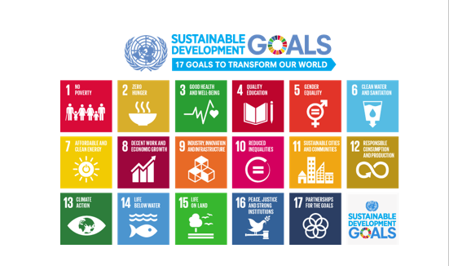
Project work mapping with SDG
SDG 11: Sustainable Cities and Communities: Our project focuses on improving the sustainability of tourism, which can contribute to sustainable urban development and better quality of life for residents.
SDG 9: Industry, Innovation, and Infrastructure: Our project leverages AI and machine learning technologies, which are considered key drivers of innovation and technological progress.

Slide 18
Thank You

